Slide 1
Full Stack Web Development and Setup Development Evironment

Slide 2
Objectives
Understand what is meant by full stack in the context of web development
Distinguish between front-end, back-end and full stack web development
Set up a Git repository and perform basic Git operations
Set up and use online Git repositories
Use Node-based modules to perform basic operations.

Slide 3
What is Full Stack Web Development?

Slide 4
Front end and Back end
Front end / Client-side
HTML, CSS and Javascript
Back end / Server-side
Various technologies and approaches – PHP, Java, ASP.NET, Ruby, Python
https://en.wikipedia.org/wiki/Front_and_back_ends

Slide 5
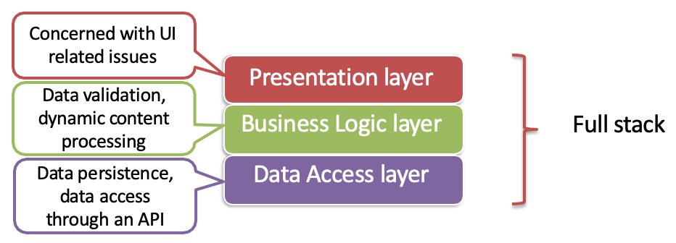
Three Tier Architecture
https://en.wikipedia.org/wiki/Multitier_architecture#Three-tier_architecture http://www.tonymarston.net/php-mysql/3-tier-architecture.html

Slide 6
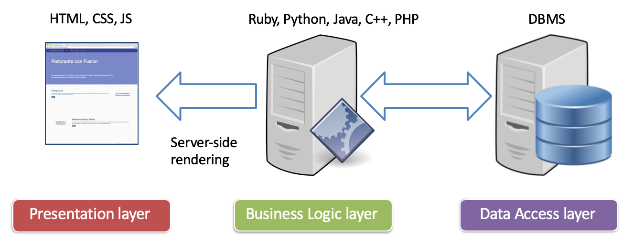
Traditional Web Development

Slide 7
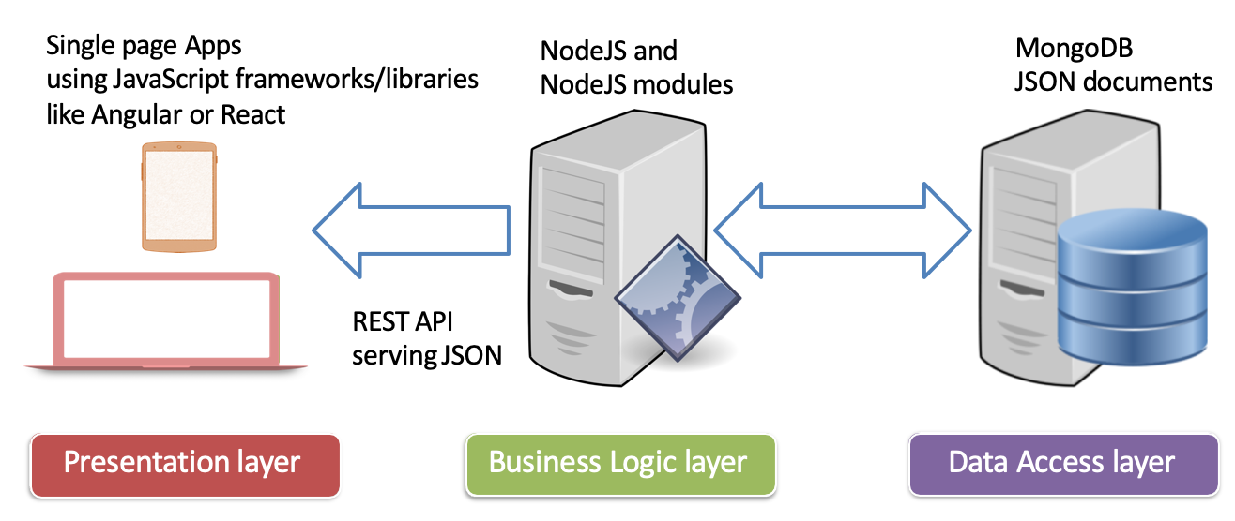
Full Stack JavaScript Development

Slide 8
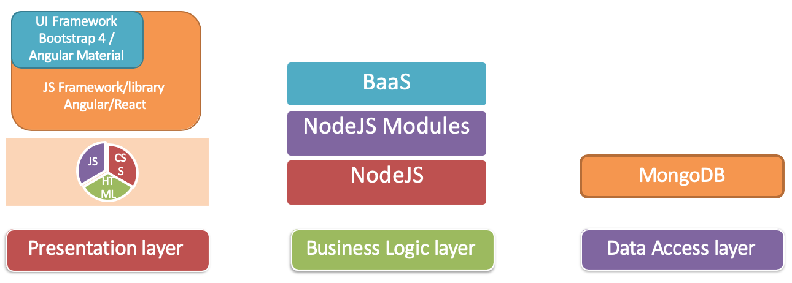
Full Stack Web Development

Slide 9
Git

Slide 10
Some Basic Concepts
Version Control: software tool(s) that enable the management of changes to source code
Maintaining version history
Several version control tools: CVS, SVN, Git etc.
Distributed version control system
Developed by Linus Torvalds for managing Linux kernel development
Widely adopted now by several projects
The Node ecosystem thrives on it

Slide 11
Exercises
Setting up Git on your machine
Using Git
Using online Git repositories

Slide 12
Exercise 1: Setting up Git

Slide 13
Exercise 2: Basic Git Commands

Slide 14
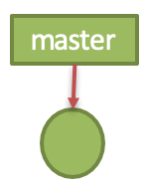
Basic Git Commands
git init
Initializes the current folder as a git repository
git status
Current status of the folder

Slide 15
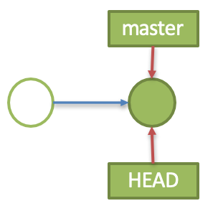
Basic Git Commands
git add <file(s)/folder(s)>
add file(s)/folder(s)to staging area
git commit
commit the changes to the git repository

Slide 16
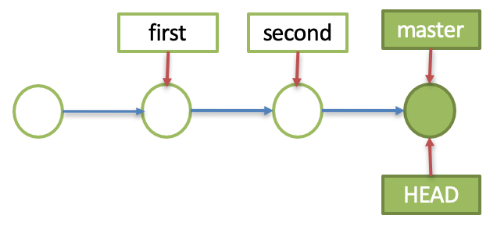
Basic Git Commands
git log --oneline
see a brief log of commits
git checkout <commit> <file>
checkout the file from an older commit

Slide 17
Basic Git Commands
git reset <file>
unstage a staged file, but leave working directory unchanged
git reset
reset the staging area to the last commit without disturbing the working directory

Slide 18
Exercise 3: Online Git Repositories

Slide 19
Online Git Repository
Several online Git repository service providers:
GitHub (https://github.com)
Bitbucket (https://bitbucket.org)

Slide 20
Online Git Repository Commands
git remote add origin <repository URL>
Add the remote online repository
git push -u origin master
push the local git repository to the origin to the master branch

Slide 21
Node.js and NPM

Slide 22
What is Node.js?
JavaScript runtime built on Chrome V8 JavaScript Engine
Uses an event-driven, non-blocking I/O model
Makes it lightweight and efficient
At this moment, we will only talk about node’s use as a JavaScript runtime
More on server-side use in a later course

Slide 23
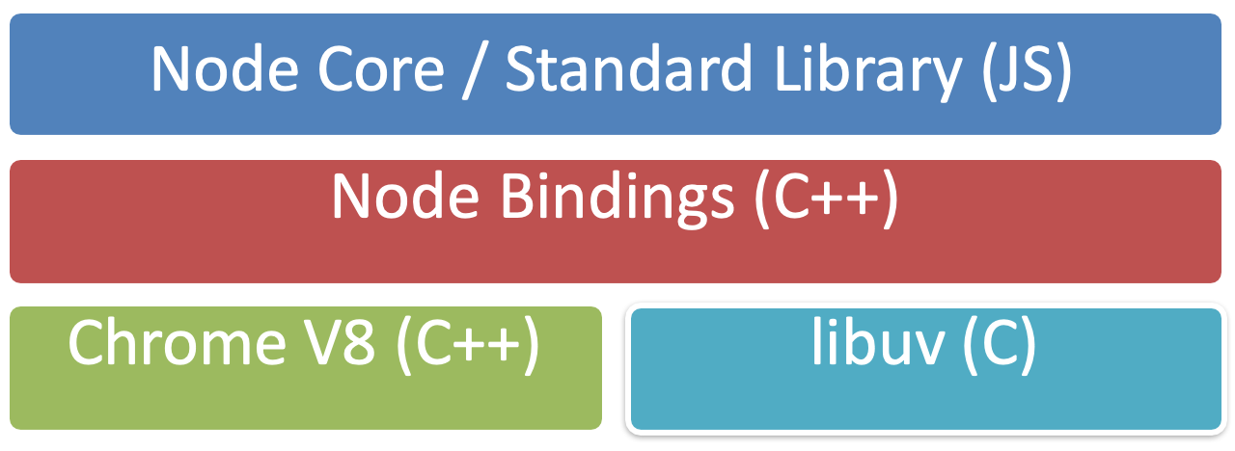
Node Architecture

Slide 24
Node.js Use Cases
Utilities written in JavaScript for web development:
Bower, Grunt, Gulp, Yeoman etc.
Server-side Development
Web server, Business logic, Database access

Slide 25
Node Package Manager
Node package manager (NPM): manages ecosystem of node modules / packages
A package contains:
JS files
package.json (manifest)

Slide 26
Exercise 4: Setting up Node.js and NPM -

Slide 27
package.json
A package.json file affords you a lot of great things:
It serves as documentation for what packages your project depends on.
It allows you to specify the versions of a package that your project can use using semantic versioning rules.
Makes your build reproducible, which means that its way easier to share with other developers.
Source: https://docs.npmjs.com/getting-started/using-a-package.json

Slide 28
Initializing package.json
To initialize a package.json file for your project, type at the prompt in your project directory:
npm init
Follow along and answer the prompts to initialize

Slide 29
Summary
Understand what is meant by full stack in the context of web development
Distinguish between front-end, back-end and full stack web development
Set up a Git repository and perform basic Git operations
Set up and use online Git repositories
Use Node-based modules to perform basic operations.

